Slide 1
Automatic indexing of a variable/question bank collection using KEA
Lorna Balkan
CESSDA Thesaurus Co-ordination Officer
UK Data Archive
10th Conference ISKO-France 2015
5-6 November 2015

Slide 2
Overview
  indexing at the UK Data Archive
  automatic indexing experiment
  experimental design
  results
  conclusions and future prospects

Slide 3
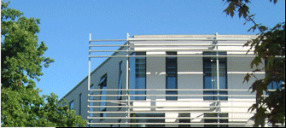
The UK Data Archive
based at the University of Essex, Colchester, since 1967
curator of the largest collection of digital data in the social sciences and humanities in the UK
holds over 6,000 data collections including large-scale government surveys, international macrodata, business microdata, qualitative studies and census data from 1971 to 2011
provides access to data via the UK Data Service

Slide 4
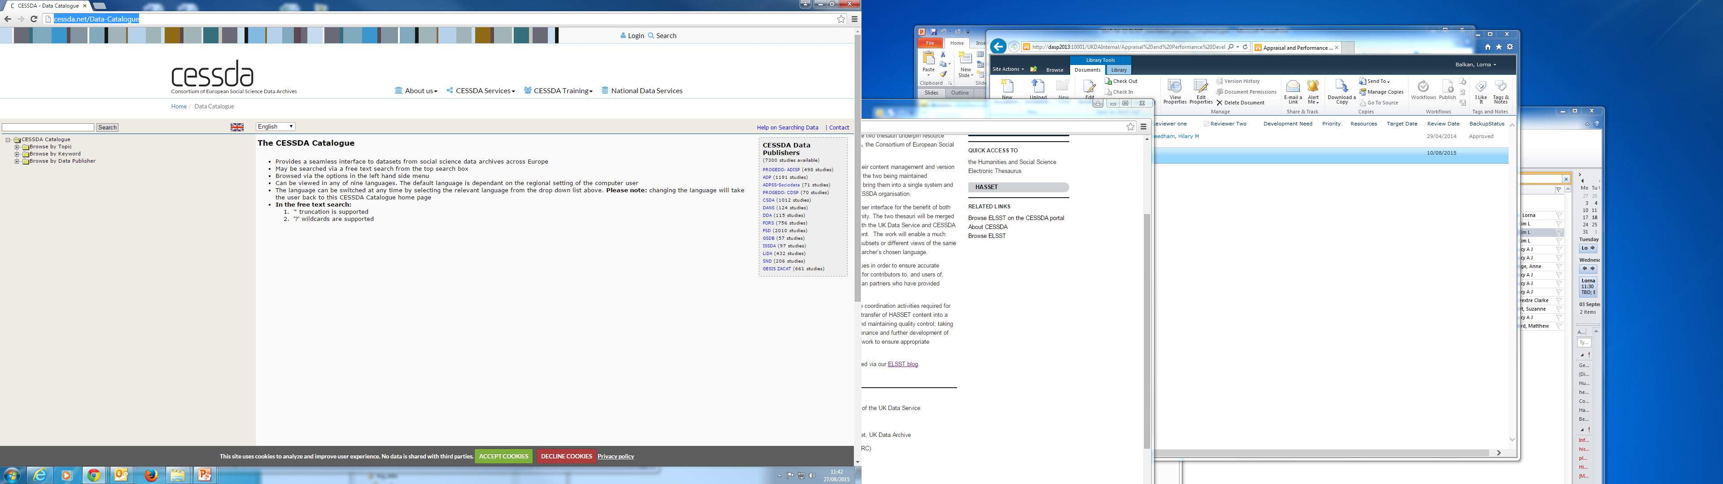
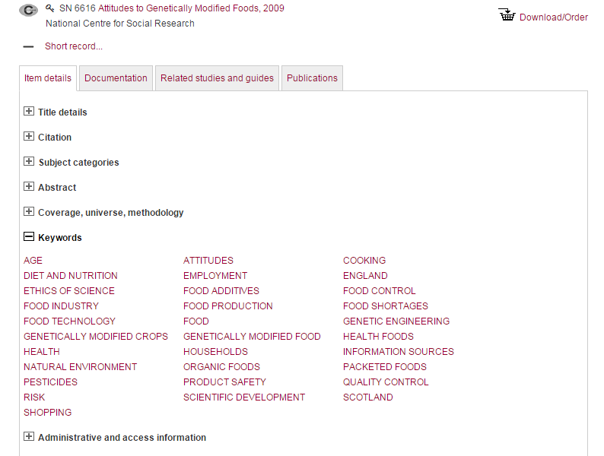
Manual indexing at UK Data Archive
catalogue record created for each dataset
includes abstract, subject categories, keywords, etc.
keywords manually assigned using HASSET

Slide 5
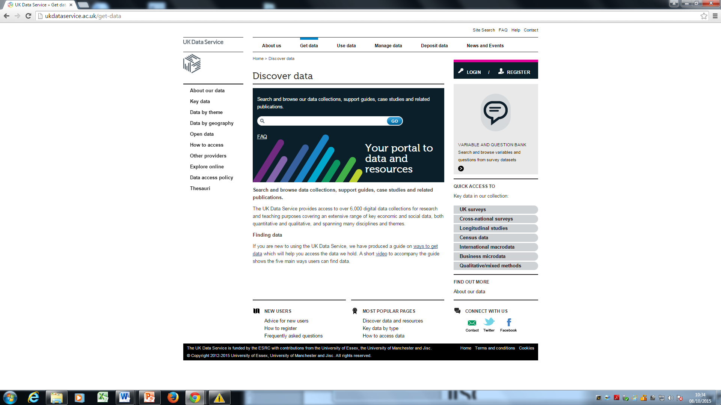

Data discovery at UK Data Service
search catalogue record using Discover

Slide 6
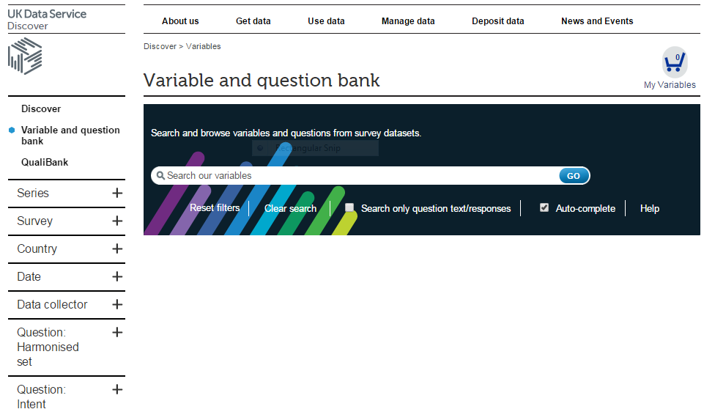
Data discovery at UK Data Service
search variables and questions of main datasets via Variables and question bank

Slide 7
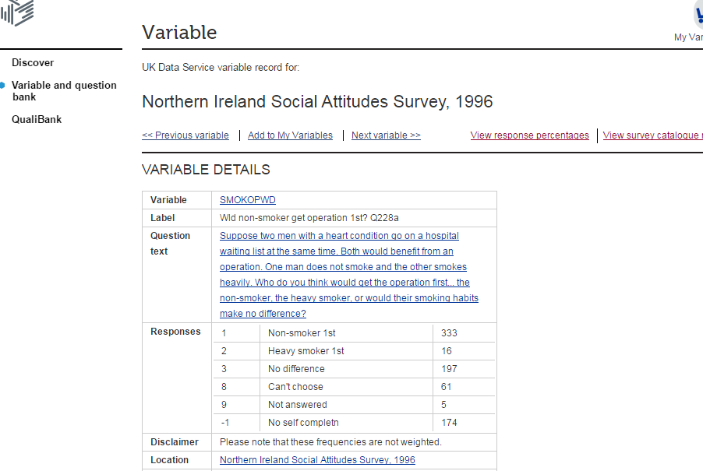

Data discovery at UK Data Service
variables may have associated question text - questions, parts of questions or marked sections of a questionnaire

Slide 8
Data discovery at UK Data Service
variables of key datasets also available to browse and explore via Nesstar

Slide 9
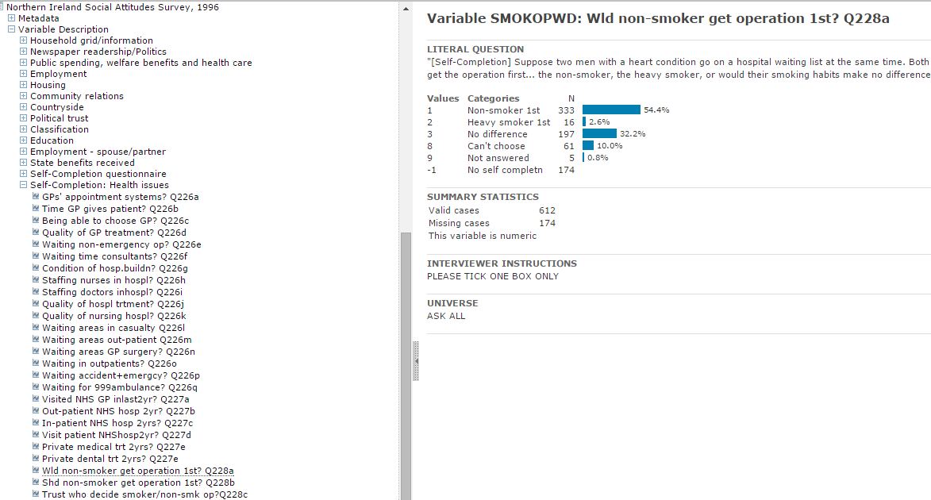
Nesstar example
variable in Nesstar showing response frequencies

Slide 10
Automatic indexing at UK Data Archive
experiment conducted as part of JISC-funded SKOS-HASSET project (2012-13)
four different corpora used in experiment, including:
  catalogue records
  questionnaires
  Nesstar variables/questions
  support guides/case studies
this presentation focuses on Nesstar corpus

Slide 11
Experimental design
the corpus
the thesaurus
the automatic indexing tool
evaluation metrics and methodology

Slide 12
Nesstar corpus
26,753 variables from 35 datasets were indexed using HASSET terms
variable label and question text combined:
e.g.
  [Self-Completion] Suppose two men with a heart condition go on a hospital waiting list at the same time. Both would benefit from an operation. One man does not smoke and the other smokes heavily. Who do you think would get the operation first... the non-smoker, the heavy smoker, or would their smoking habits make no difference? Wld non-smoker get operation 1st? Q228a
  the median number of manual keywords assigned per example was 3-4 keywords

Slide 13
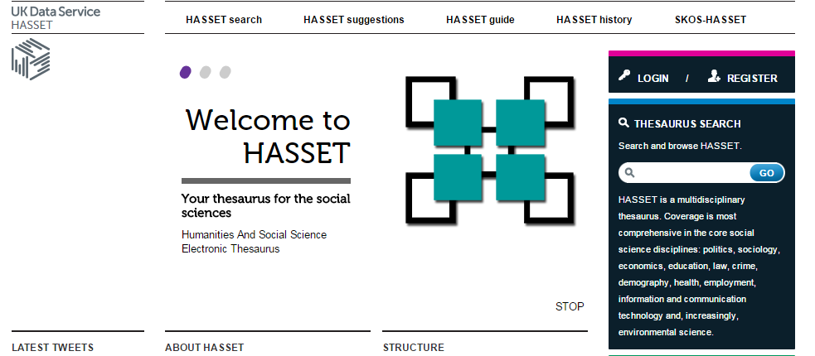
HASSET thesaurus
Humanities And Social Science Electronic Thesaurus (HASSET)
the leading British English thesaurus for the social sciences
developed at UK Data Archive for over 30 years
currently funded as part of CESSDA-ELSST project, together with its multilingual cousin, the European Language Social Science Thesaurus (ELSST)

Slide 14
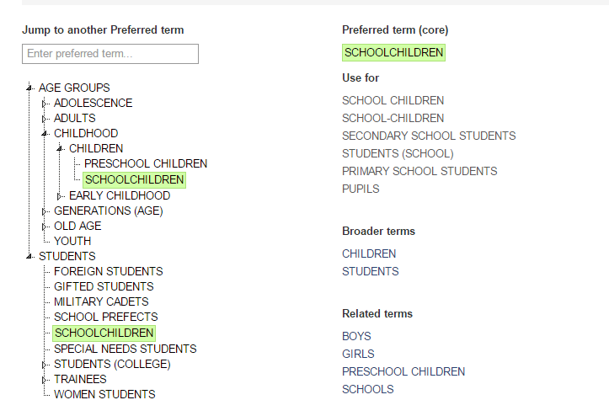
HASSET thesaurus
contains usual thesaural relationships:
  - Preferred terms (PTs) - Broader terms (BTs)
  - Use For terms (UFs) - Related terms (RTs)

Slide 15
HASSET thesaurus
at time of experiment, contained 12,233 terms
geographical terms were excluded from the text mining exercise, leaving a total of 8,830 terms (Preferred and Use For terms)

Slide 16

KEA
Keyword Extraction Algorithm (KEA)
freely available and has been used extensively for automatic indexing
two main steps:
  candidate term identification:
    applies stop-words and stemming
    maps candidate terms (n-grams) to HASSET PTs
  filtering
    uses learned model to find most significant keywords based on features such as tf.idf (term frequency-inverse document frequency)
    returns ranked list of keywords

Slide 17
Evaluation metrics and methodology
Nesstar corpus divided into:
  training corpus (80%)
  test corpus (20%)
KEA trained on training corpus then applied to test corpus
threshold set to 10 keywords per example
evaluation results reported for test corpus only

Slide 18
Evaluation metrics and methodology
two types of evaluation:
  automatic: performed on whole of test corpus
  manual: performed on 50 examples from test corpus
both used standard evaluation metrics of precision and recall

Slide 19
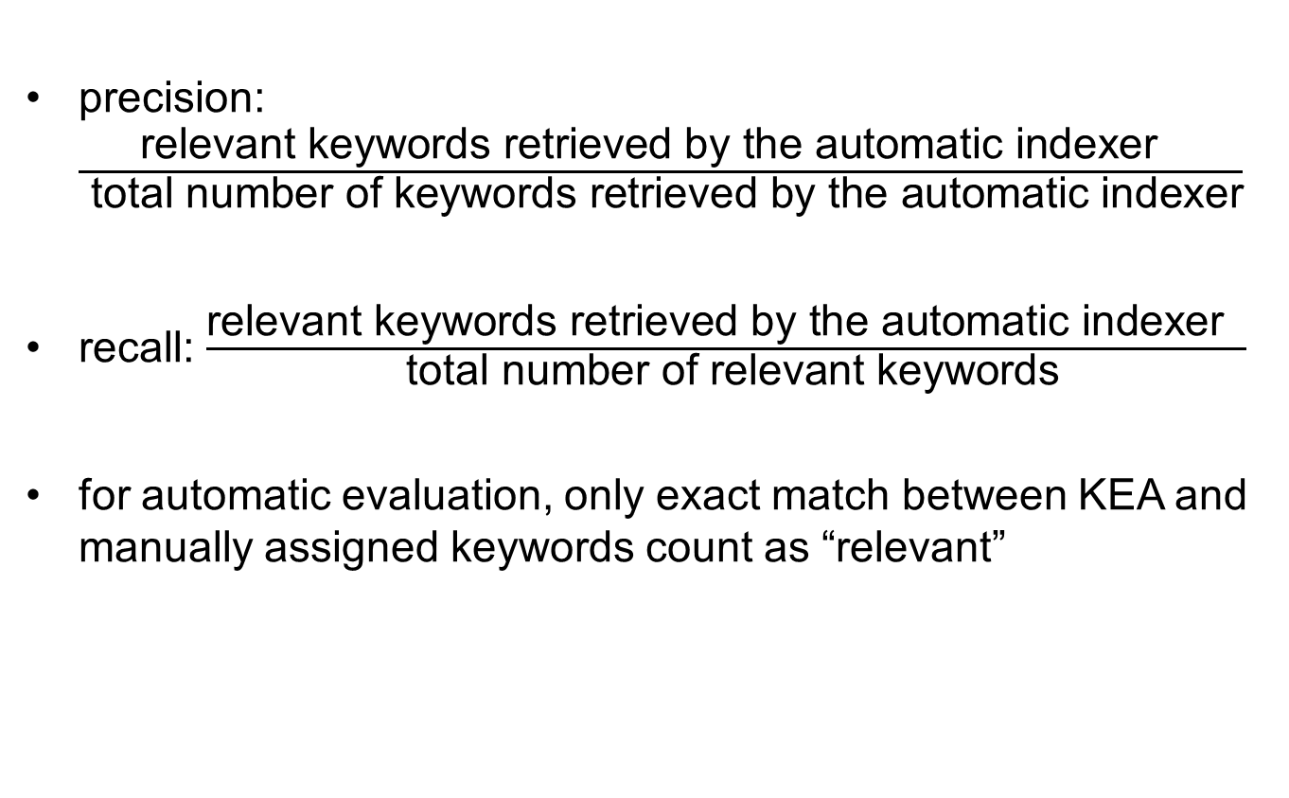
Precision and recall
precision: $\frac{\text{relevant} \text{keywords} \text{retrieved} \text{by} \text{the} \text{automatic} \text{indexer} }{ \text{total} \text{number} \text{of} \text{k}\text{eywords} \text{retrieved} \text{by} \text{the} \text{automatic} \text{indexer}}$
recall: $\frac{\text{relevant} \text{keywords} \text{retrieved} \text{by} \text{the} \text{automatic} \text{indexer} }{ \text{total} \text{number} \text{of} \text{relevant} \text{k}\text{eyword}\text{s}}$
for automatic evaluation, only exact match between KEA and manually assigned keywords count as “relevant”

Slide 20
Manual evaluation
evaluators asked to judge:
how suitable KEA term is for indexing:
    completely suitable
    partially suitable
    unsuitable
    both ‘completely suitable’ and ‘partially suitable’ considered ‘relevant’
    if ‘partially suitable’ or ‘unsuitable’, whether KEA term:
    too broad
    too narrow
    redundant
    completely wrong (‘unsuitable’ terms only)

Slide 21
Evaluation form

Slide 22
Results of manual evaluation
precision: 40%
recall: 40%
question: what caused errors and could the system performance be improved?
performed error analysis

Slide 23
Precision error analysis
too broad | too narrow | redundant | completely wrong
18% | 0% | 3% | 79%

Slide 24
Redundancy
Have you received any on-the-job training in the course of this (job/apprenticeship) 39? YP: Whether received any on the job training in the course of usual work
Manual keywords | KEA
EMPLOYMENT-SPONSORED TRAINING | IN-SERVICE TRAINING
APPRENTICESHIPS | TRAINING COURSES
 | FURTHER TRAINING
 | SHORT COURSES
 | EMPLOYMENT

Slide 25
Reasons for ‘completely wrong’ errors
  over-stemming (39%)
    e.g. REGULATIONS matched ‘regularly‘ in:
    Which of these precautions or forms of contraception do you use most regularly? …
presence of the term in incidental text (37%)
    e.g. LESSONS was assigned to:
    Does your school have times, either before or after lessons, where you can just drop in to work on your own or with other students rather than with a teacher?
    even though the question is not about lessons

Slide 26
Reasons for ‘completely wrong’ errors
  Homonyms (16%)
e.g. SURFING (in HASSET it means sport), was assigned to:
    Which of the following types of activities do you use this computer for at home? Browsing or surfing the Internet. Activities computers used for - browsing / surfing the internet
  Parse error (2%)
e.g. SCHOOL TIME was assigned to:
    Does your school have times, either before or after lessons, where you can just drop in to work on your own or with other students rather than with a teacher?
  due to the removal of the stop-word ‘have’

Slide 27
Recall error analysis
not in text | not recognised
82% | 18%

Slide 28
Recall errors not in text
terms too abstract
  e.g. INDUSTRIAL RELATIONS PROCEDURES appears in text as:
  Which of the following are allowed to accompany an employee at a grievance meeting? ..
concepts expressed as noun phrases in HASSET appear as verbs in text:
  e.g. CAREER GUIDANCE appears in the text as:
  ..Whether teacher/careers advisor told YP that they should get an apprenticeship…

Slide 29
Not all recall errors equally bad
in 28% cases where recall errors were found, suitable alternative keywords were suggested by KEA. E.g:
  Can I just confirm that there (is a/is no) joint committee of managers and employees at this workplace which deals with health and safety matters?
Manually assigned keyword KEA failed to find | KEA keyword assigned instead
OCCUPATIONAL SAFETY | WORKPLACE
 | HEALTH
 | SAFETY AND SECURITY

Slide 30
Suggestions for improving precision
broad terms:
  either remove altogether or suppress if narrower also assigned
  but both may sometimes be necessary
stemming:
  either remove stemming or try less aggressive stemming algorithm
  but would have impact on recall
apply part of speech (POS) tagging
e.g. MORAL CONCEPTS (UF = GOOD) would not be assigned to:
And how much do you agree or disagree that... I get good marks for my work? I get good marks for my work..

Slide 31
Suggestions for improving precision
exploit text structure:
  identify text that is not relevant to indexing, such as user instructions
reduce the number of very similar terms in the thesaurus (e.g. those related to training):
  would improve automatic indexing and the quality of the thesaurus

Slide 32
Suggestions for improving recall
adjust the preprocessing of the text to reduce formatting errors
add UFs to HASSET: this would improve the usefulness of the thesaurus in general

Slide 33
Conclusion and future prospects
some improvements possible – further work needed
unlikely to reach level of human indexers
best as support for, rather than replacement for, human indexing
operational evaluation needed to test this
applications include use in self-archiving system, ReShare
also useful for thesaurus construction – results feeding into CESSDA-ELSST project

Slide 34
References
UK Data Archive: www.data-archive.ac.uk/
UK Data Service: ukdataservice.ac.uk/
HASSET thesaurus: hasset.ukdataservice.ac.uk/
ELSST thesaurus: elsst.ukdataservice.ac.uk/
SKOS-HASSET project: http://www.data-archive.ac.uk/about/projects/skos-hasset
CESSDA-ELSST project page: ukdataservice.ac.uk/about-us/projects/cessda-elsst/details.aspx

Slide 35
Thank you!

Slide 36
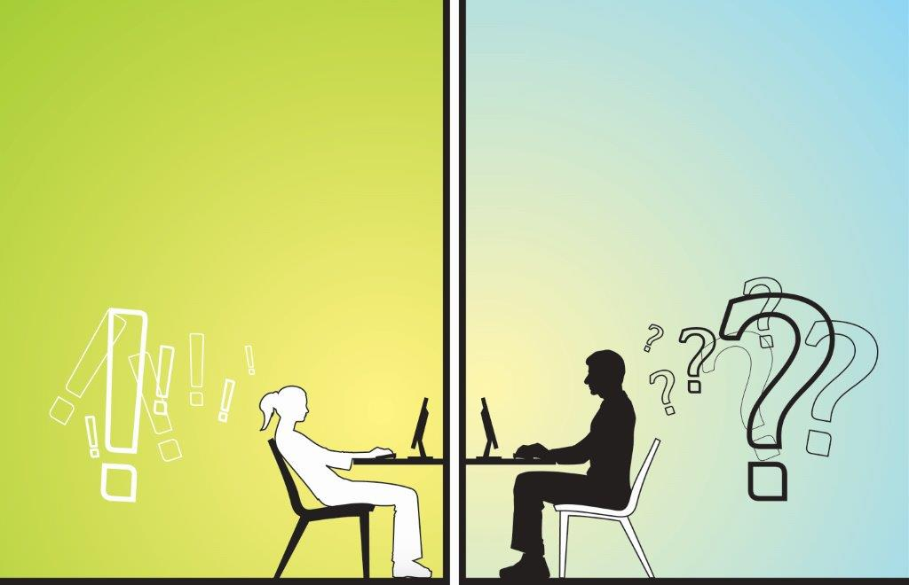
Contact Details
Lorna Balkan:
balka@essex.ac.uk

